Slide 1
Marathi Social Media Opinion Mining using XLM-R
International Conference on Applied Artificial Intelligence and Computing – ICAAIC 2022
AUTHORS:
NAITIK RATHOD
DHRUV TALATI
NISHIT MISTRY
MANAN PARIKH
ANIKET KORE
PRATIK KANANI

Slide 2
Introduction
With an increase of opinionated user data on social media, capturing user sentiments could help in determining public opinion on various agendas.

Slide 3
Introduction
With an increase of opinionated user data on social media, capturing user sentiments could help in determining public opinion on various agendas.
Problem Statement: Resource-constrained languages like Marathi, Gujarati, face the issue of scattered as well as scarce datasets as sharing of data becomes difficult due to sensitive nature of text.

Slide 4
Introduction
With an increase of opinionated user data on social media, capturing user sentiments could help in determining public opinion on various agendas.
Problem Statement: Resource-constrained languages like Marathi, Gujarati, face the issue of scattered as well as scarce datasets as sharing of data becomes difficult due to sensitive nature of text.
Proposed Solution: We use Transformer XLM-RoBERTa to train sentiment analysis model for Marathi language.

Slide 5
Literature Survey
XLM-Roberta models
Conneau et al., (2020)
Goyal et al., (2021)
Other Works
Divate et al., (2021) – Marathi News sentiment analysis
Gupta et al., (2021) – Hindi CNN based Twitter Sentiment Analysis.
Ghafoor et al., 2021 – Impact of translating resource rich to low resource languages.
De et al., (2021) – Hostility in Hindi using Multilingual Model.
Seliverstov et al., (2021) – Toxicity detection using XLM-R

Slide 6
Dataset Used
L3CubeMahaSent dataset
Approx 16000 tweets in Marathi language scraped from twitter and annotated for sentiment analysis task.
15388 tweets were available for each sentiment
Training used over 12000 tweets
Testing was done using 2250 tweets
Validation sets had 1500 tweets
Each of these had equal division of each sentiments.

Slide 7
Tokenization - Roberta
Roberta Tokenizer is used for tokenizing the tweets before training of the models. It uses byte level BPE as a tokenizer.
This tokenizer is derived from the GPT-2 tokenizer and is commonly used for tokenizing for the language models.
The XLM-RoBERTa specifically uses Roberta tokenizer due to the structure of the transformer.

Slide 8
Methodology
Models:
XLM-R base (Conneau et al., 2020)
XLM-R large (Goyal et al., (2021)
We report the mean accuracy after training on 3 random seeds on both the transformer models trained for 25 epochs on every run.

Slide 9
Results of XLM-R base and large
 | XLM-R Base | XLM-R Large
Accuracy(%) | 82.5% | 83.82%

Slide 10
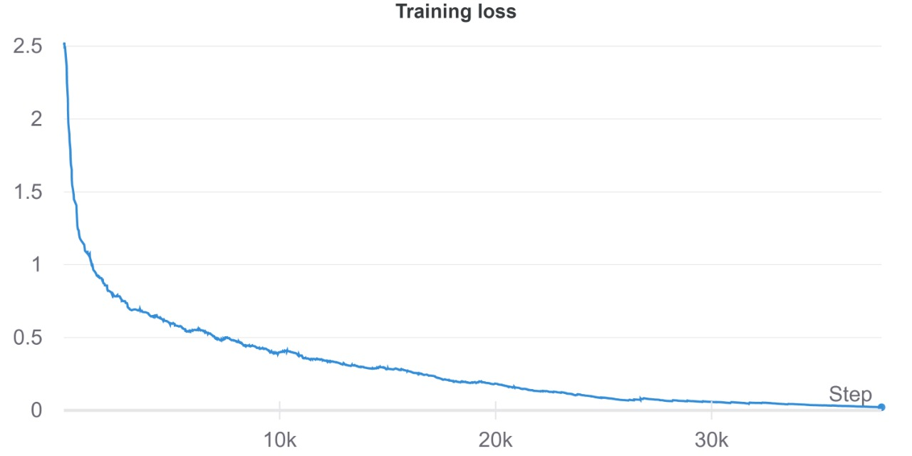
Training Loss Graph

Slide 11
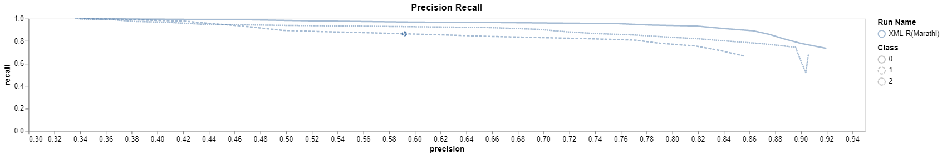
Precision-Recall curve

Slide 12
Conclusion
In this paper, we have used the XLM-R base and large model due to its higher accuracy and better performance for NLP tasks on low resource languages like Marathi.
The results achieved are comparable to the current best available models for the Marathi Sentiment Analysis tasks.
Further higher accuracies can be achieved using larger transformers like XLM-R XL and XXL or even using further expanded datasets on any other models.

Slide 13
THANK YOU!

